Slide 1
Cereal API
By: Rebekka
Notes:
Explain a bit about Cereal API

Slide 2
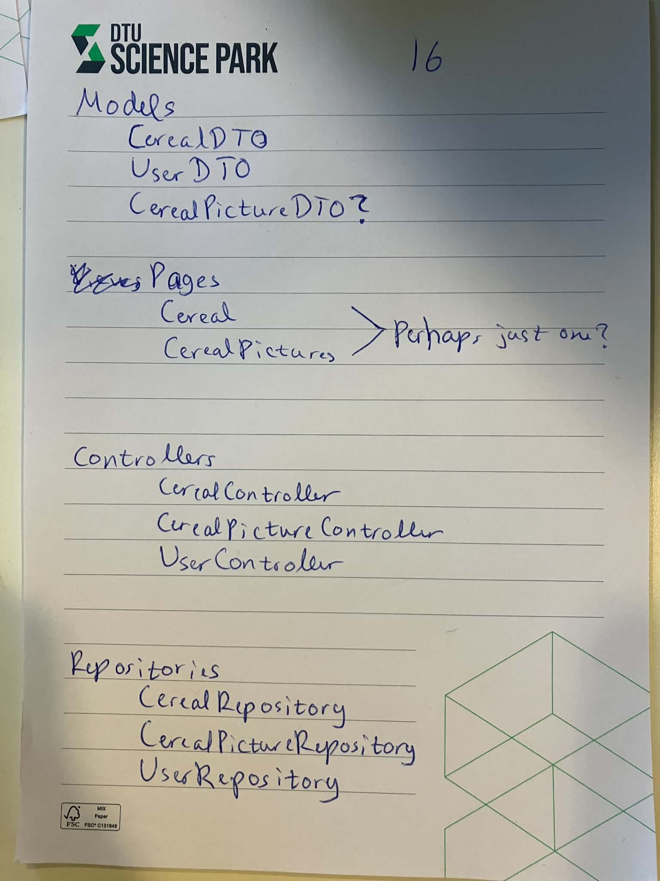
Beginnings
How to make an API from scratch?
Figure out architecture (MVC)
Test Driven Development (TDD)

Slide 3
Frameworks & Technologies
Blazor
SQLite
Visual Studio

Slide 4
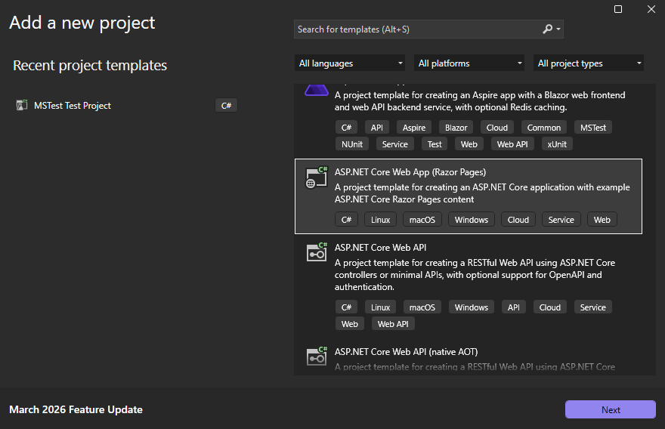
Visual Studio pros and cons
Templates
”Supports” xUnit
Notes:
Shoutout to Michael

Slide 5
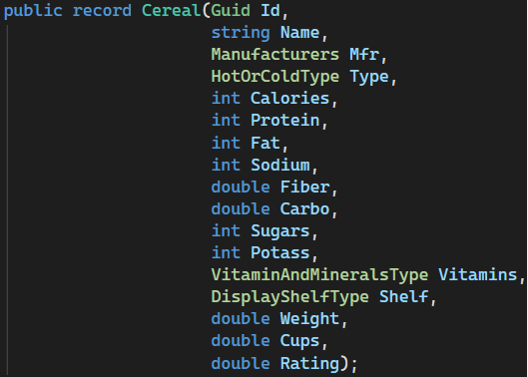
Cereal Data Model
Notes:
At the core of my project
Enums -> the right choice?

Slide 6
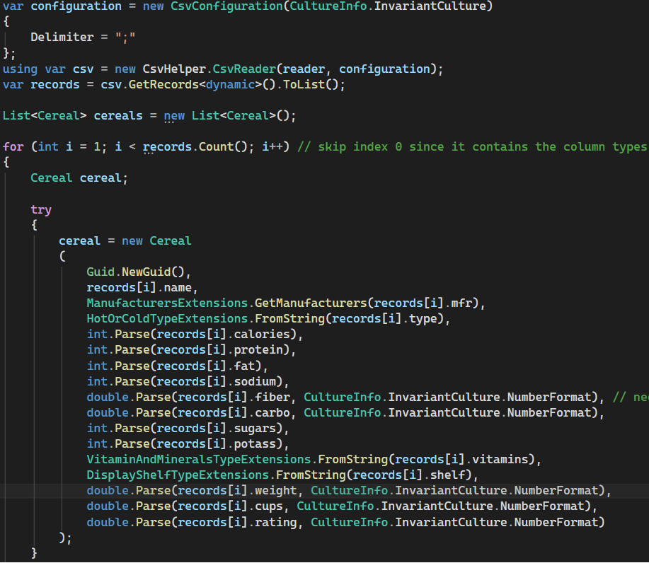
Parsing
Notes:
CSVHelper-library -> all strings
Custom enum parsers
Trail off into adding data into the database

Slide 7

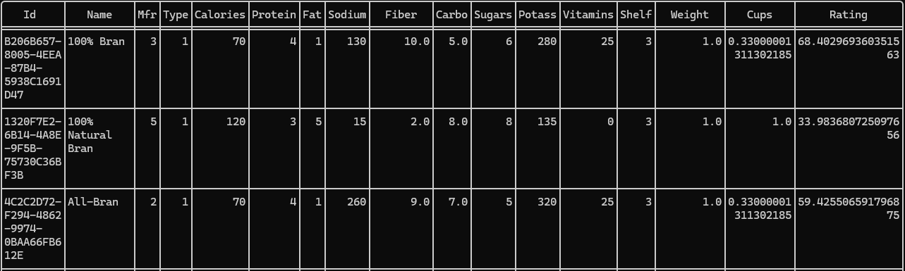
Parsing shenanigans
Notes:
Data in csv-file
SQLite database

Slide 8
Parsing shenanigans
Notes:
Floats are weird man

Slide 9
Parsing shenanigans
Notes:
Floats are weird man

Slide 10
Parsing shenanigans
Notes:
Floats are weird man
Very glad I had pushed this onto a branch and not the main branch!

Slide 11
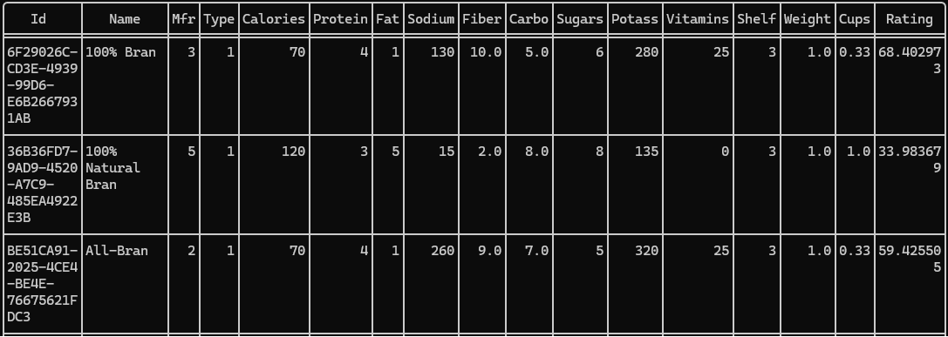
Parsing shenanigans
Notes:
Doubles for the win

Slide 12
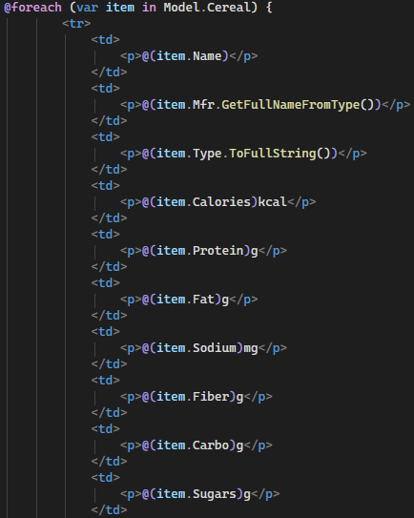
Frontend to backend
Etc.

Slide 13
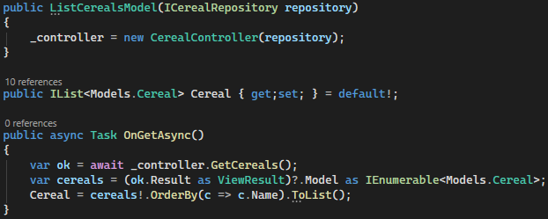
Frontend to backend
Notes:
In View, or rather Pages/Cereal/ListCereals.cshtml.cs

Slide 14
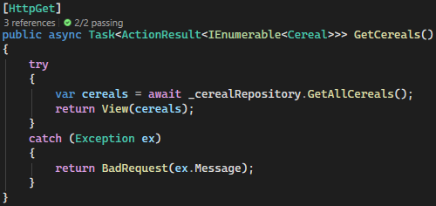
Frontend to backend
Notes:
In controller
Http-requests

Slide 15
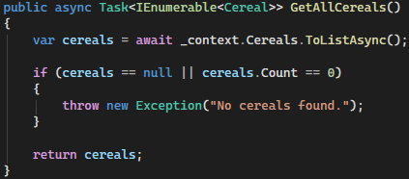
Frontend to backend
Notes:
In repository

Slide 16
Demo
デモンストレーション
Notes:
Show the database real quick!
Show the visual part!

Slide 17
Reflections
Don’t want to use Visual Studio
Always think about the things you’re given
Notes:
Visual Studio -> For another project like this, want to use the templates but not the IDE.

Slide 18
Reflections
Nowhere close to finished
Might continue after ExOpi
Notes:
Setting up something from scratch when you’ve done it before just takes time (though also lost a lot of time to CV-stuff)
Not hard to implement remaining stuff, just a matter of getting started

Slide 19
fin
終わりです

